Slide 1
Vocabulary Week #1

Slide 2
Abbreviate
(V)Verb
Doctor = Dr.
To shorten, abridge

Slide 3
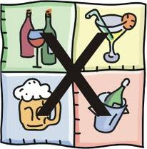
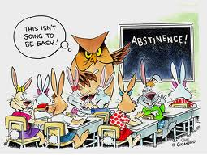
ABSTINENCE
P.O.S. NOUNS
ACT OF REFRAINING FROM

Slide 4
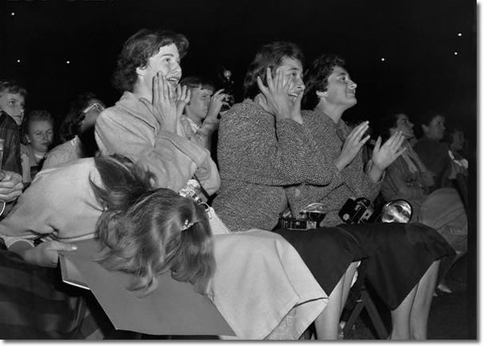
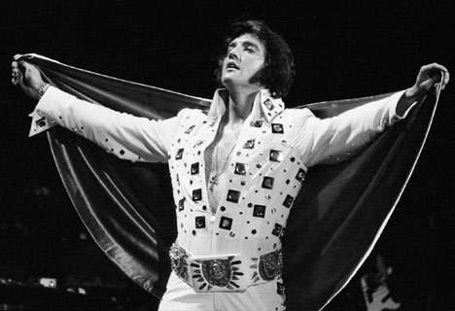
Adulation
(n.)
High praise

Slide 5
Benevolent
Adj.
Friendly and helpful

Slide 6
Camaraderie
n.
Trust, sociability amongst friends

Slide 7
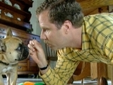
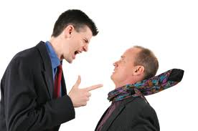
Censure
http://www.hulu.com/watch/4102/saturday-night-live-dissing-your-dog
TO CRITICIZE HARSHLY
P.O.S. VERB

Slide 8
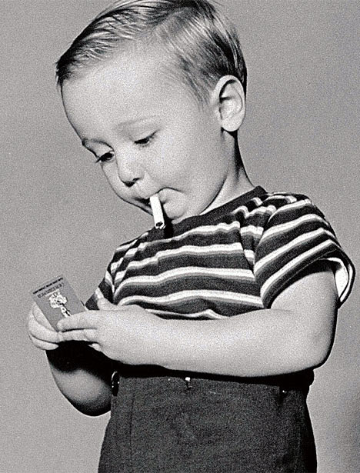
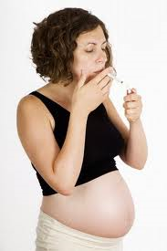
Deleterious
adj.
Harmful, destructive, detrimental

Slide 9
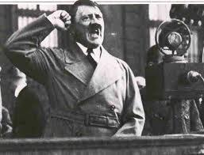
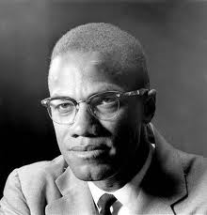
DEMAGOGUE
Leader who appeals to popular desires or prejudices
Rabble-Rousing Leader
Noun

Slide 10
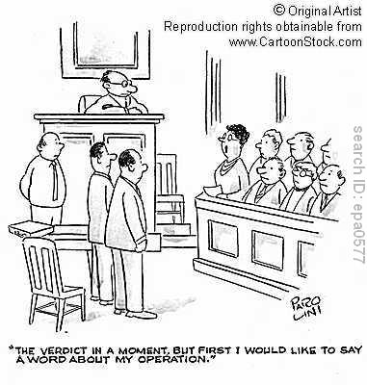
Digression
(noun)
Straying from the main point

Slide 11
Empathy
n.
Identification with the feelings of others

Slide 12
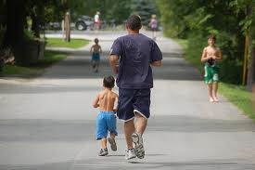
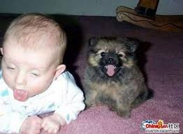
EMULATE
P.O.S. VERB
FOLLOW AN EXAMPLE

Slide 13
Florid
Adj.
Red colored, flushed

