Slide 1
STEMS LIST #7

Slide 2
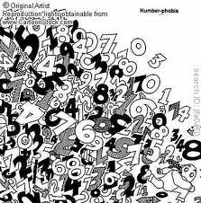
NUMER=NUMBER
NUMEROUS
NUMERALS

Slide 3
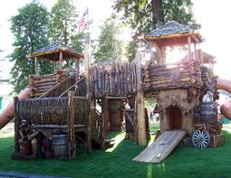
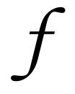
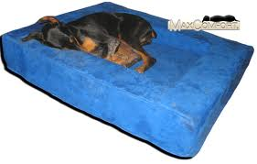
FORT=STRONG
= FORTE
FORT
COMFORTABLE

Slide 4
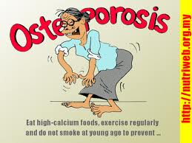
OSTEO=BONE
OSTEOPOROSIS

Slide 5
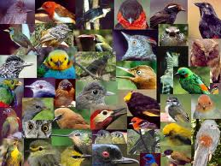
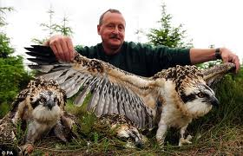
ORNITH=BIRDS
ORNITHOLOGIST
ORNITHOLOGY:
THE STUDY OF BIRDS

Slide 6
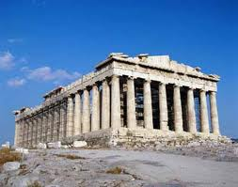
POLIS=CITY
ACROPOLIS
POLICE

Slide 7
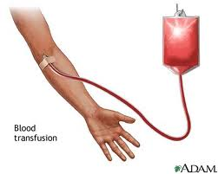
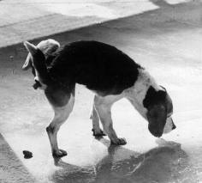
FUS=POUR
TRANSFUSION
CONFUSION

Slide 8
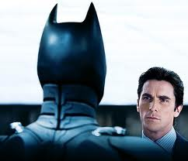
EGO=I
ALTER EGO
EGOMANIACS

Slide 9
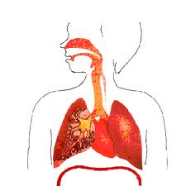
SPIR=BREATHE
PERSPIRE
EXPIRED
RESPIRATION

Slide 10
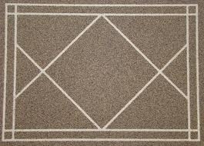
DIA=ACROSS
DIALOGUE
DIAGONAL

Slide 11
ACR=SHARP
http://video.google.com/videoplaydocid=-7854267796277099036#

Slide 12
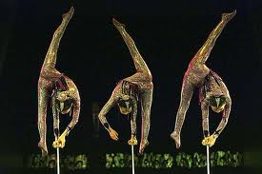
ACRO=HIGH
ACROBAT
ACRONYM

Slide 13
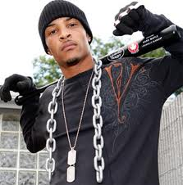
CULP=BLAME
CULPRIT

Slide 14
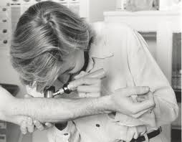
DERM=SKIN
PACHYDERM
DERMOTOLOGIST

Slide 15
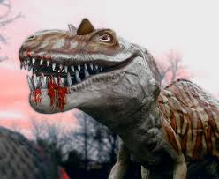
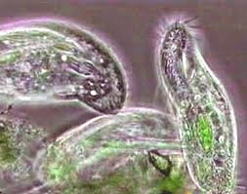
ZO=ANIMAL
MESOZOIC
PROTOZOA

Slide 16
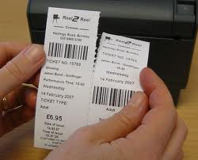
PER=THROUGH
P
E
R
C
O
L
A
T
E(R)
PERFORATION

Slide 17
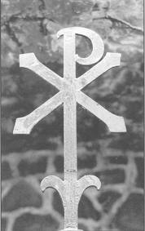
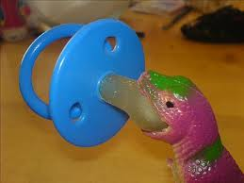
PAC=PEACE
PACIFY
PAX ROMANA

Slide 18
BREV=SHORT
ABBREVIATION

Slide 19
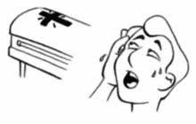
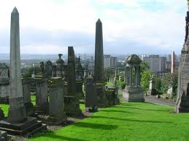
NECRO=DEATH
NECROPHOBIA
NECROPOLIS

Slide 20
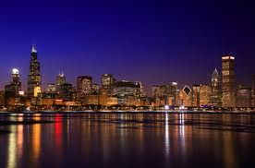
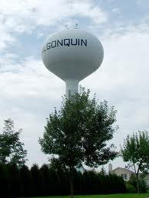
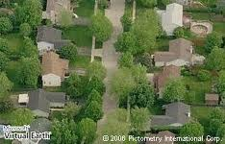
URB=CITY
URBAN
SUBURBAN

Slide 21
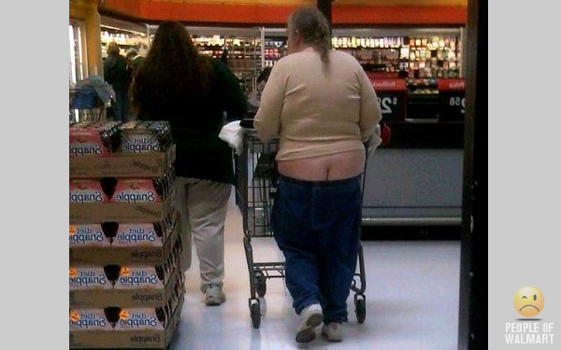
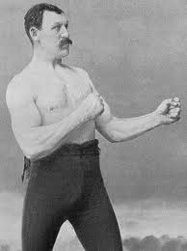
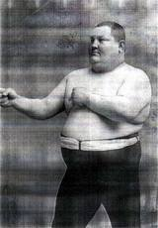
PUGN=FIGHT
REPUGNANT
PUGILISTS

Slide 22
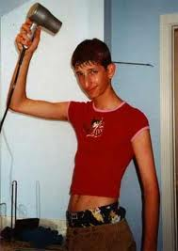
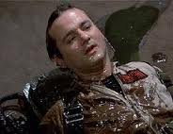
ECTO=OUTER
ECTOMORPH
ECTOPLASM

Slide 23
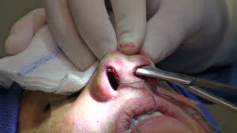
PLASTO=MOLDED
RHINOPLASTY
PLASTICITY

Slide 24
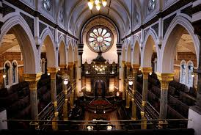
AGOG=LEADER
SYNAGOGUE
PEDAGOGY

Slide 25
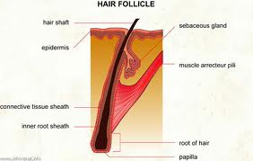
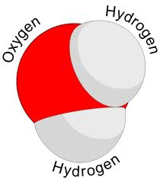
CLE=SMALL
MOLOCULE
FOLLICULE

Slide 26
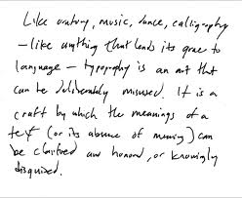
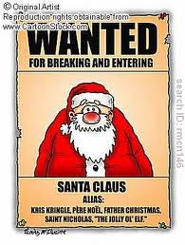
IL=NOT
ILLEGAL
ILLEGIBLE

