Slide 1
Antigone
Short Position Paper

Slide 2
What’s your position?
Decide if you support Antigone’s position on burying her brother, or King Creon’s position on not burying him.
You do not necessarily need to pick the one you AGREE with, just the one you have enough evidence to PROVE and SUPPORT.

Slide 3
Position Paper
Uses reasoned argument and EVIDENCE to support the position you take on the topic
Has an introduction, 3 body paragraphs, and a conclusion
Should be 2 to 3 pages in length, double spaced and in MLA formatting

Slide 4
Quick Review: Intro Paragraphs
Four components of an introduction paragraph:
Attention getting
sentences 1-2 sentences
2. Using the name of the
story, and author 1 sentence
3. Explanation sentences 2-4 sentences
4. Thesis statement 1 sentence
An introduction paragraph should be approximately
5-8 sentences!

Slide 5
Intro
Attention getter: Ask a relevant question, make a relevant startling statement
CATCH THE ATTENTION OF THE READER!
Did you know…
In this paper I will tell you about…
Webster’s dictionary defines…

Slide 6
Use of Title and Author
This is so we know what the heck you are talking about in the rest of your paper.
This information should connect the attention getter to the actual background of Antigone and be incorporated into the background info
Antigone should be italicized
The author is Sophocles

Slide 7
Standing up for what one believes in is not always easy to do, and can lead to punishment or death. In Antigone by Sophocles, one woman risks… while King Creon…

Slide 8
Background info/Thesis Statements
Tell the reader enough so that he/she knows what the central conflict is about
Thesis is where you give your position on the conflict
I believe Antigone is right because
I will prove Antigone is right because
You will see that Antigone is right because
Antigone has the stronger argument because____, ______, and _________.

Slide 9
Quick Review: Thesis Statements
A thesis statement:
is ALWAYS the last sentence of your introduction paragraph.
Makes a bold, interesting statement about your topic that leaves your reader wanting to read the rest of your paper.
Should address the prompt that is given to guide the writing
Never use I, me , we, you, or yourself!

Slide 10
Leading to First TELLCON
Thesis statement should incorporate 3 reasons why you are supporting one or the other side
Those three things will be the topic sentence of 3 TELLCON paragraphs
Each TELLCON needs 3 pieces of evidence with links (explanation as to why they prove your character is right)

Slide 11
3 Body Paragraphs
TELLCon
Topic- the argument for Antigone or Creon- 1 reason for each paragraph
Evidence- directly from the text with page number that proves topic
Link- connect the topic sentence to the evidence
Language- make sure to reread, edit, and make sure that the sentences make sense together
Conclusion- wraps everything together and restates the topic in DIFFERENT words

Slide 12
EACH TELLCon is organized like this:
Topic- one reason from your thesis that supports your paper Evidence=quote Link- explain how the quote supports/proves topic Evidence=quote Link- explain how the quote supports/proves topic Evidence=quote Link- explain how the quote supports/proves topic CON- restate topic in different words, summing everything up together

Slide 13
To add a quote here or there…
Plopping a quote in the middle of a paragraph does not count as style.
Remember to avoid: “This quote explains” “This quote shows” “In this quote”
Antigone has the better position in this argument against Creon because she is following the gods’ laws only. Antigone proves that she is above Creon’s law when she says, “I say that this crime is holy” (192). By calling burying her brother a holy crime, she is removing herself from guilt in the eyes of the men in the government. She believes that, while she commits a crime on earth, she is actually following a more important law, God’s. In another example, Antigone shows that she is being holy when she says, “….”….

Slide 14
Conclusions
A conclusion should:
Be seven sentences long
Summarize the evidence you have examined and what it indicates about your character- NOT an exact copy of your introduction
End with something to think about, or a wrap up statement, but NEVER a question or a thanks for reading statement

Slide 15
Plagiarism
Plagiarism is a personal pet peeve of mine, and of all authors everywhere.
When you plagiarize, you are taking credit for something that isn’t yours, even if your audience knows what you are talking about
It is against the law.
Bottom line, if it is not done properly, I will dock you- big time
“I began to think there was some skill involved in being a girl” (Lee, 116).
Very easy, right?

Slide 16
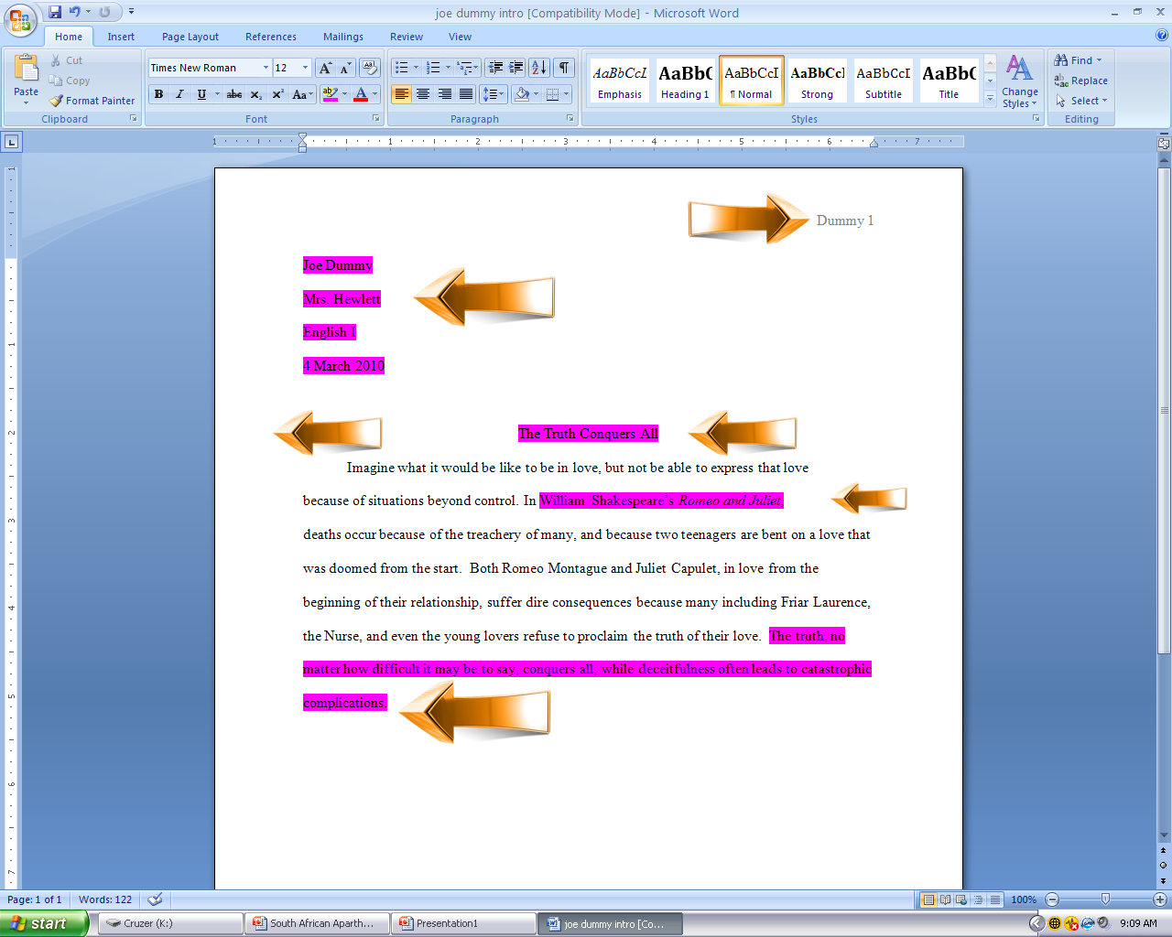
Quick Review: MLA Formatting:
1. Use Times New Roman 12
2. Have 1 inch margins
3. Have a header
Your last name
Page number
3. Have a heading
Your Name
Teachers Name
Class, Hour
Date
4. Have an interesting, unique title

Slide 17
Where do we go from here?
1 intro
3 TELLCon (3 quotes each)
1 conclusion
You can submit a TYPED copy of your paper Wednesday or Thursday for Mrs. Eccles and Mrs. Loete to look over and give feed back for:
10 extra credit points TOMORROW
5 extra credit points THURSDAY
Friday we will be gone to a conference and so…
YOUR FINAL DRAFT IS DUE ON MONDAY. We will spend 20 minutes on this tomorrow, and that is IT for class time, so take care of all your questions tomorrow.
TAKE ADVANTAGE OF opportunities that are presented to you.

