Slide 1
WEEK 4
GET SOME!!!!

Slide 2
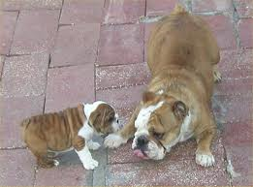
MEEK, GIVES IN
SUBMISSIVE
ADJ.

Slide 3
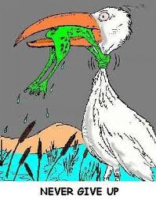
Persistant, does not give up
TENACIOUS
ADJ.

Slide 4
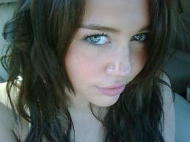
AMBIGUOUS, SLY, SNEAKY
SUBTLE
ADJ

Slide 5
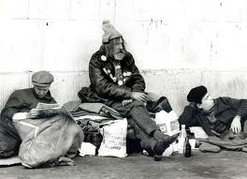
TEMPORARY
TRANSIENT
ADJ

Slide 6
LACKING DEPTH
SUPERFICIAL
ADJ.

Slide 7
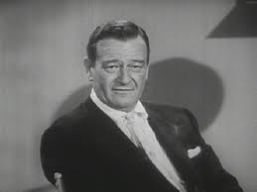
RESPECTABLE DUE TO AGE
VENERABLE
ADJ

Slide 8
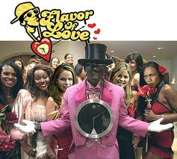
MORE THAN ENOUGH/EXCESIVE
SUPERFLUOUS
ADJ

Slide 9
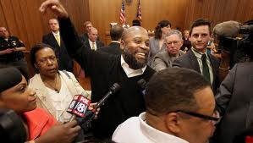
TO CLEAR FROM BLAME
VINDICATE
VERB

Slide 10
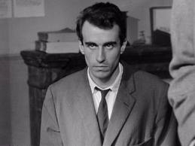
SECRETLY, STEALTH
SURREPTITIOUS
ADJ.

Slide 11
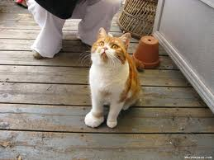
WATCHFUL, ALERT
WARY
ADJ

